Slide 1
SQLite3!

Slide 2
Lesson Objectives
PK and FK
ERD – Entity Relationship Diagram
CREATE table and other syntax
Basic query examples
Challenge

Slide 3
Primary & Foreign Keys
employees
departments
managers
PK employee_id: int
first_name:text
family_name: text
PK department_id: int
department_name
FK manager_id
FK employee_id
PK manager_id: int
department_name
first_name:text
family_name: text
What relationships could we use between these tables?
Are there any many-to-many relationships? If so, what can we do to remove the many-to-many relationships?

Slide 4
Primary & Foreign Keys
wheels
cars
steering_wheel
PK wheel_id: int
quantity: int
PK car_id: int
make
model
colour
seats
FK steering_wheel_id
FK wheel_id
PK steering_wheel_id: int
colour: text
quantity: int
What relationships could we use between these tables?
Are there any many-to-many relationships? If so, what can we do to remove the many-to-many relationships?

Slide 5
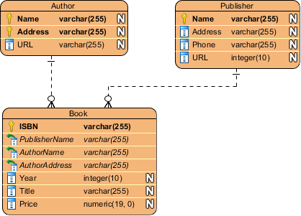
Primary & Foreign Keys
“
Database is absolutely an integral part of software systems. To fully utilize ER Diagram in database engineering guarantees you to produce high-quality database design to use in database creation, management, and maintenance. An ER model also provides a means for communication.
Links - https://www.visual-paradigm.com/guide/data-modeling/what-is-entity-relationship-diagram/
“
VisualParadigm have an excellent article which has several different ERDs and explains their relationships. They also discuss ERDs in context with a Data Flow Diagram. Have a read for 10 mins

Slide 6
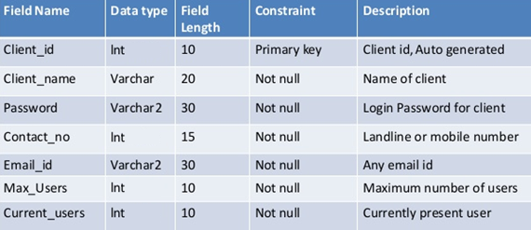
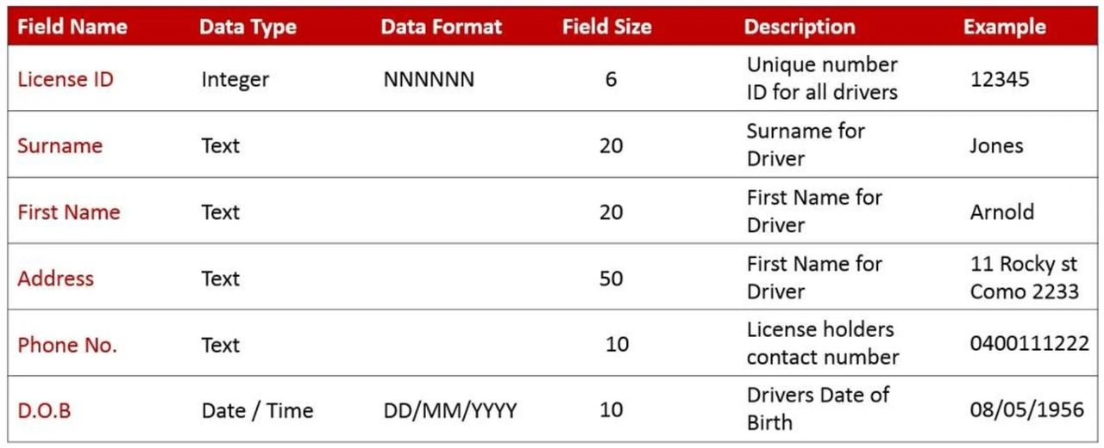
Data Dictionary
A set of information describing the contents, format, and structure of a database and the relationship between its elements, used to control access to and manipulation of the database.
Below is a good example of a data dictionary with constraints. You can create one data dictionary per table. I find it easier to use something like Excel or Google Sheets

Slide 7
Syntax
All the SQLite statements end with a semicolon (;).
SQLite is case-insensitive, meaning that keywords like SELECT, INSERT, UPDATE, DELETE, ALTER, DROP, etc. are treated the same regardless of capitalization.
SQLite uses single-line comments starting with - -
SELECT * FROM students;
-- Select courses taught by "Dr. Smith"

Slide 8
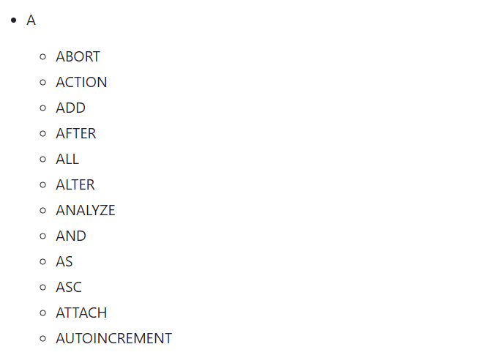
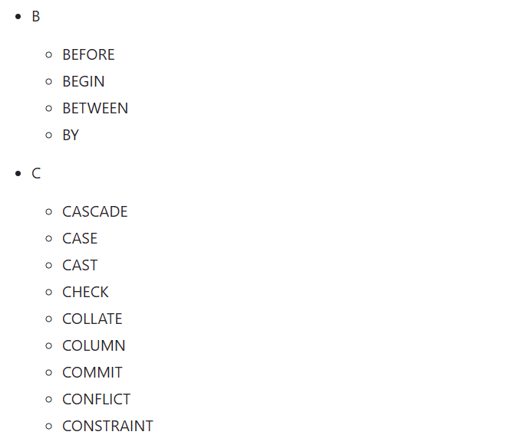
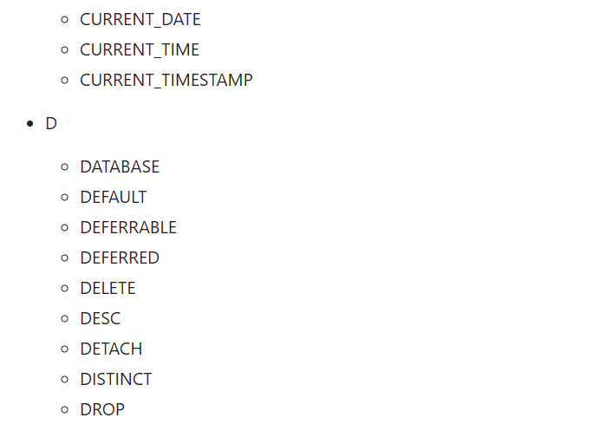
Syntax – reserved words

Slide 9

Syntax – reserved words
SELECT col1, col2 FROM tablename;
CREATE TABLE tablename( col1 datatype, col2 datatype, PRIMARY KEY( one or more columns ) );
INSERT INTO tablename(col1, col2) VALUES (val1, val2);
UPDATE tablename SET col1 = val1, col2 = val2 [ WHERE CONDITION ];
SELECT col1, col2 FROM tablename WHERE CONDITION-1 {AND|OR} CONDITION-2;
DELETE FROM tablename WHERE {CONDITION};

